Slide 1
Pathfinder Player Tool
Models and Design
David Cindric
Matthew Johnson
29, September 2014
Slide 1

Slide 2
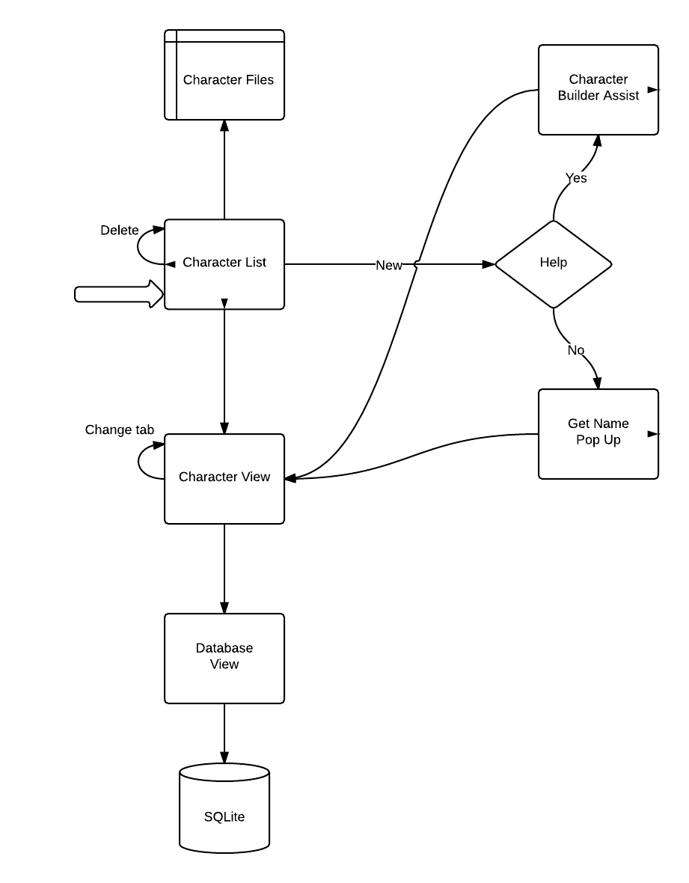
Process Model
Start
Slide 2

Slide 3
Data Model
Slide 4

Slide 4
Design Choices
Slide 5

